Slide 1



Physically Accurace Boundary Handling in Discrete Cardiac Diffsuion
Charley Chang

Slide 2
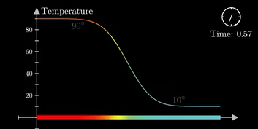

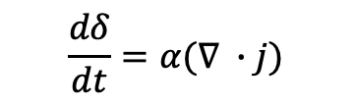
Fickian Based Diffusion System
Back in 1800s, mathmaticians are interested in modeling how diffusive quantities evolves throughout time.
Modeling of Heat Transfer
Modeling of Molecular Diffusion
Hot Rod
Cold Rod
Wikipedia & 3b1b
$$j=−D\frac{dδ}{dx}$$
$$\frac{dδ}{dt}=α(∇ ∙j)$$
Governing Equations for all Fickian Based System
Notes:
Wikipedia, 3b1b

Slide 3
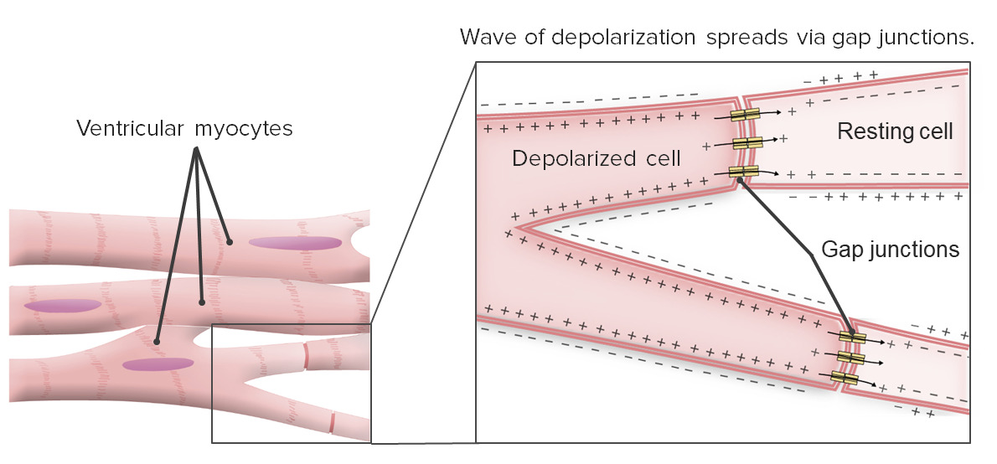
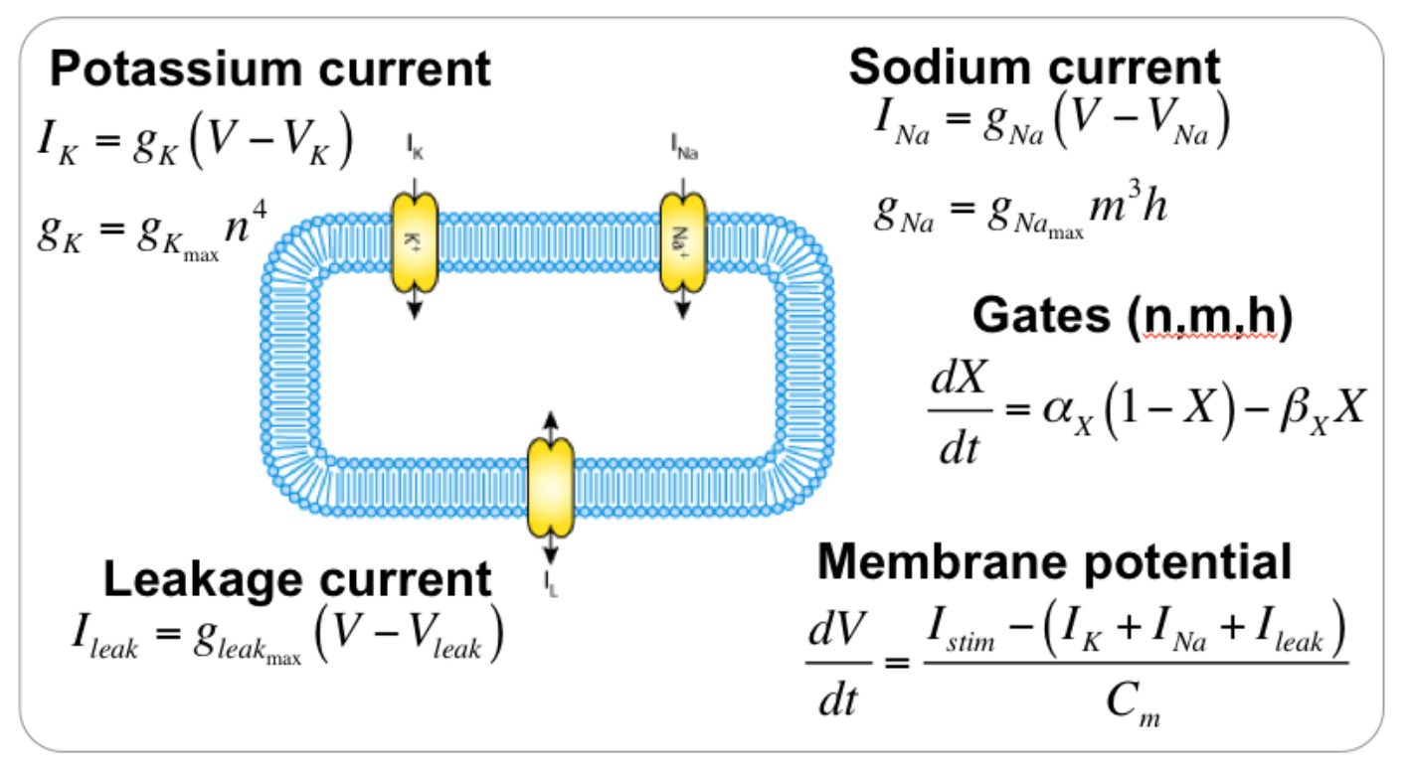
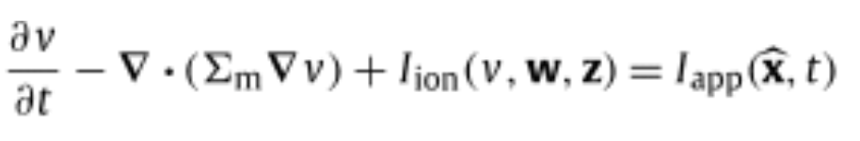
Cardiac Conduction Is a Reaction Diffusion System
Cell-Based Ionic Flow Governed By Ionic Channels
Inter-Cell Flow Can be Modeled by Diffusion
AlilaMedicalMedia & Wikipedia
Reaction
Diffusion
Cardiac Reaction-Diffusion Equation

Slide 4
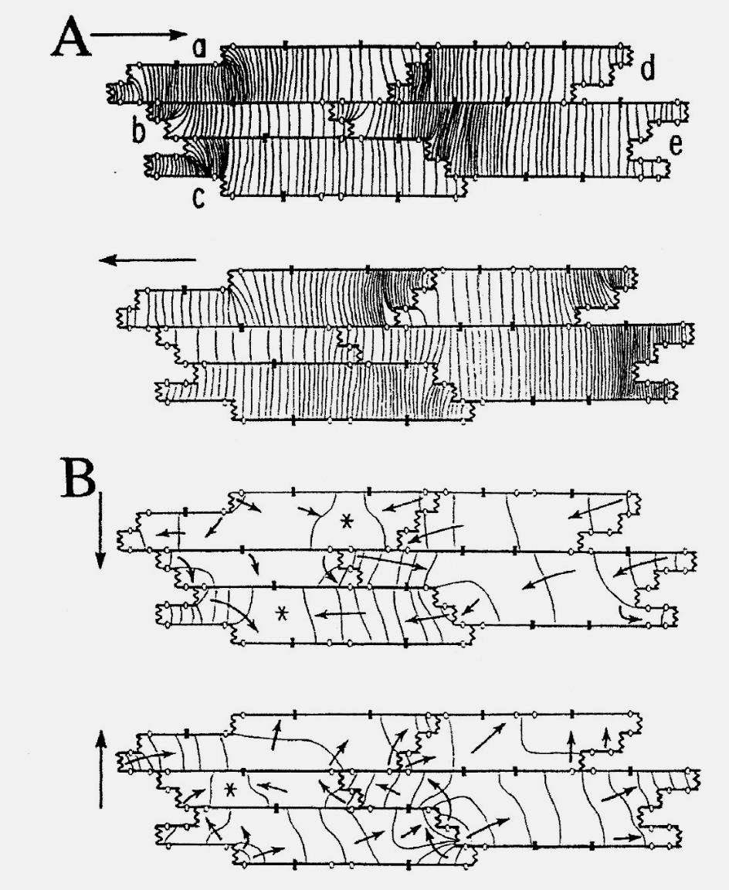
Cardiac Conduction is Also Discrete Diffusion
Hi-res cardiac conductions are segmented and non-globally smooth
Isochrone of Vm During Cardiac Conduction
Heat Transfer Simulation of Square Plate
Cardiomyocytes are connected by gap junctions
Solutions to Vm inside cells are relatively smooth
Solutions to diffusion between cells are complex and discrete
Issue: Heat Equation simulation always smooth out solutions
Rohr et al., 2017

Slide 5
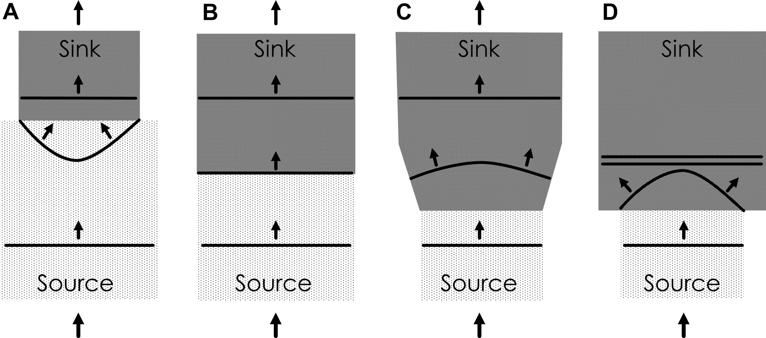
Source Sink Mismatch and Wavefront Curvature
In non-discrete reaction-diffusion system, geometric constriction or dilation is the only way to cause UNIFORM wavefront to curve
Ciaccio et al., 2017
Source = Sink
Source $<$ Sink
No curvature
Concavity Forms

Slide 6
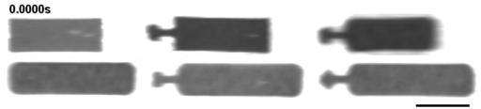
Evidence of Boundary Speedup in Tissue Chips
Is uniform wavefront truly the relax state for propagating AP wavefront?
Lee et al., 2017
Observation: No. Evidence of lateral boundary speed up occurs despite no severe geometry pinching
Hypothesis 1
Hypothesis 2
Extracellular Induced Short Circuit
Local source-sink mismatch

Slide 7
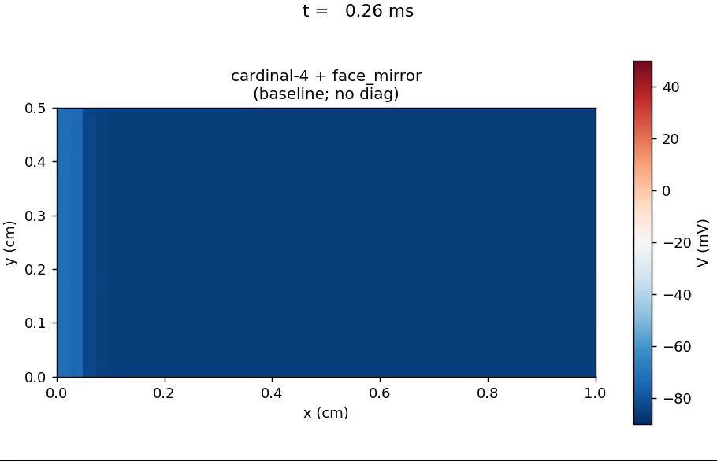
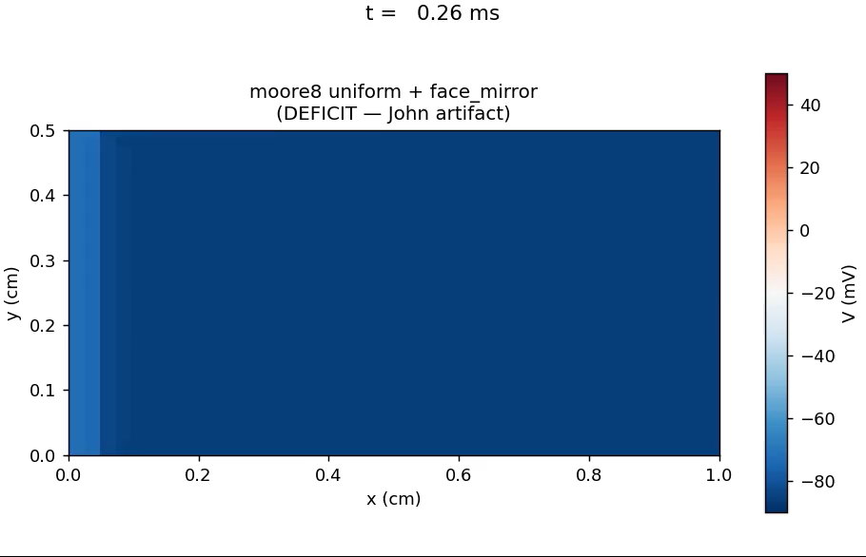
Discrete Cardiac Connective Patterns
Numerical analysis are intrinsically discrete. What discrete features creates imbalance?
Various Tissue Connection Networks
Different Directional Connective Patterns
Cardinal
Moore
Monodomain Simulation w Different Connective Patterns
Modeling cardiac tissue networks on structural grid requires diagonal connections
Adding diagonal connections could lead to boundary speed changes
Where is the “source” of this source-sink mismatch?
Cardinal
Moore

Slide 8
Streaming vs Receiving
The laterial discrete source-sink mismatch occurs when there is an imbalance between receiving less vs draining less compared to the center cells.
Effect 1: Boundary cells receive less source
Effect 2: Boundary cells stream to less sink
Favors Cresent Wavefront
Favors Inverse Cresent Wavefront
Can we control which effect wins? Does Moore connection have a bias towards effect 1?
Cardinal
Moore

Slide 9

Streaming vs Receiving Cont.
We can control which effects dominate by focusing on how boundary conditions are enforced.
In cardiac simulation, we usually impose a no-flux boundary (but only to the normal direction).
Iso padding the ghost cells
Face mirror padding the ghost cells
nw
n
ne
nw
n
ne
nw
n
ne
nw
n
ne
w
c
e
w
c
e
w
c
e
w
c
e
sw
s
se
sw
s
se
sw
s
se
sw
s
se
Favours Uniform Wavefront
Favors Cresent Wavefront
There must be a boundary condition formulation that favors steady state inverse cresent wavefront
Issue: Monodomain simulation has limitations regarding different combo of boundary conditions

Slide 10

LBM Engine Allows Control Over Directional Streaming
We need LBM: A simulation that tracks phase space instead of positional space
Medium
Positional Encoding (Monodomain)
Phase Encoding (LBM)
$$V(x,t)$$
$$f(x,c,t)$$
What is the voltage at location x at time t
What is the voltage density at location x with a velocity of c and at time t

Slide 11
Inverse Crescent Formation Supplemental
In LBM, you have direct control over the reflected direction and target of the ghost cell
Half-Way Bounce Back
Specular Bounce Back
nw
n
ne
nw
n
ne
nw
n
ne
nw
n
ne
w
c
e
w
c
e
w
c
e
w
c
e
sw
s
se
sw
s
se
sw
s
se
sw
s
se
Favours Cresent Wavefront
Favours Uniform Wavefront

Slide 12

Inverse Crescent Formation Supplemental
What if we horizontally stream back the bounce to the neighbor cells
Horizontal Bounce Forward
Combined Bounce Back
nw
n
ne
nw
n
ne
nw
n
ne
nw
n
ne
w
c
e
w
c
e
w
c
e
w
c
e
sw
s
se
sw
s
se
sw
s
se
sw
s
se
Weighted Combination fo HBB, Specular, and Horizontal
Favours Inverse Cresent Wavefront
Full Control Over Steady State Wavefront

Slide 13
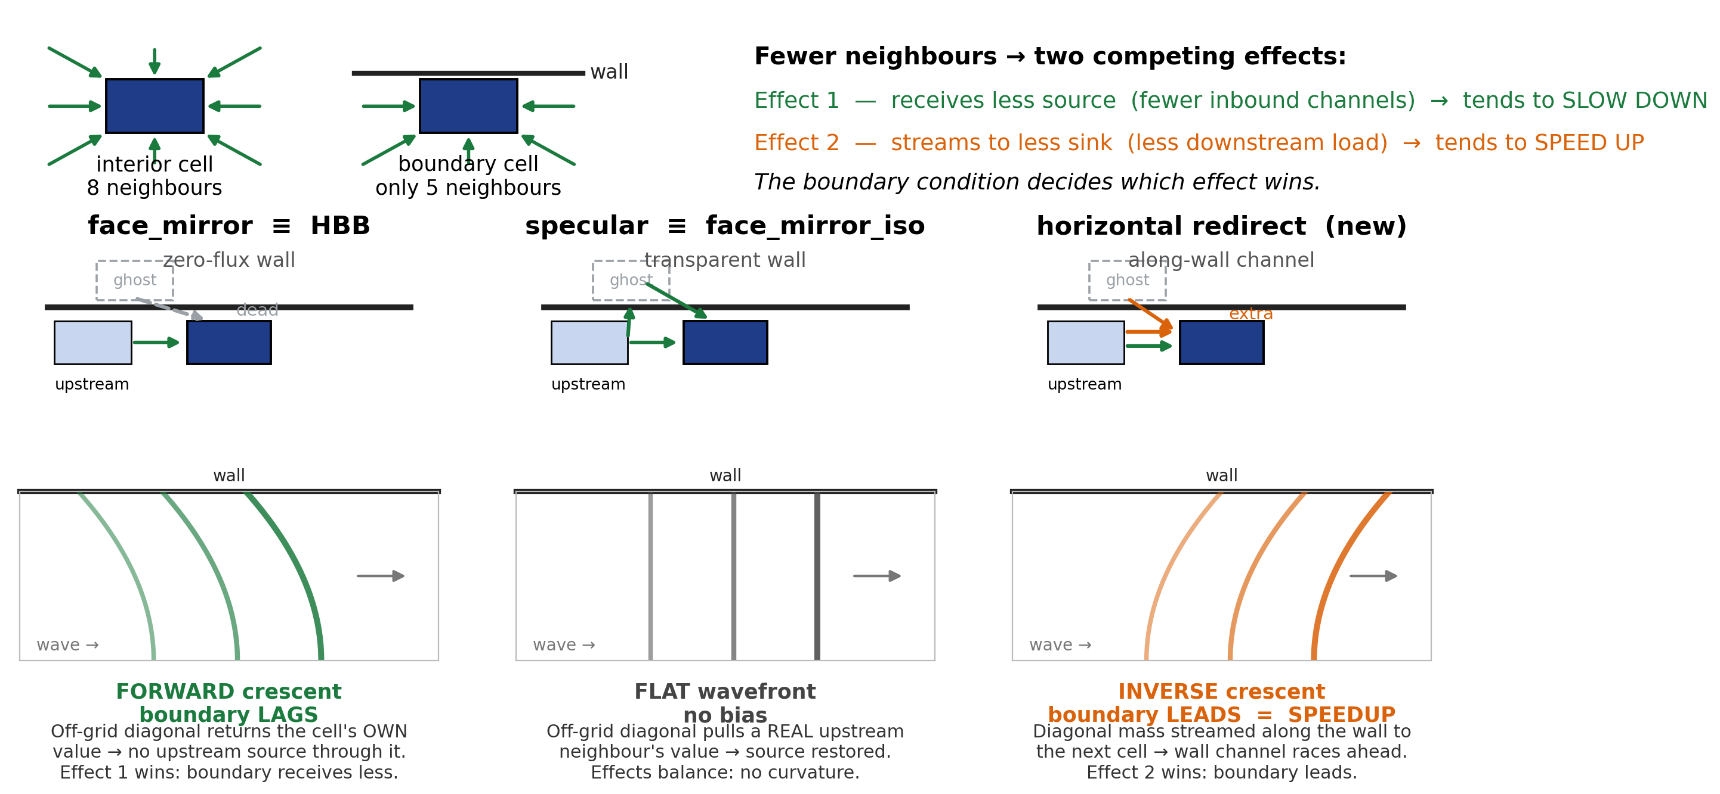
Boundary Rules Set the Crescent
Takeaway: one source–sink imbalance, three wall rules — face-mirror / HBB starves the edge (forward crescent), specular is neutral, and the new horizontal-redirect over-feeds it (inverse crescent = boundary speed-up).

Slide 14
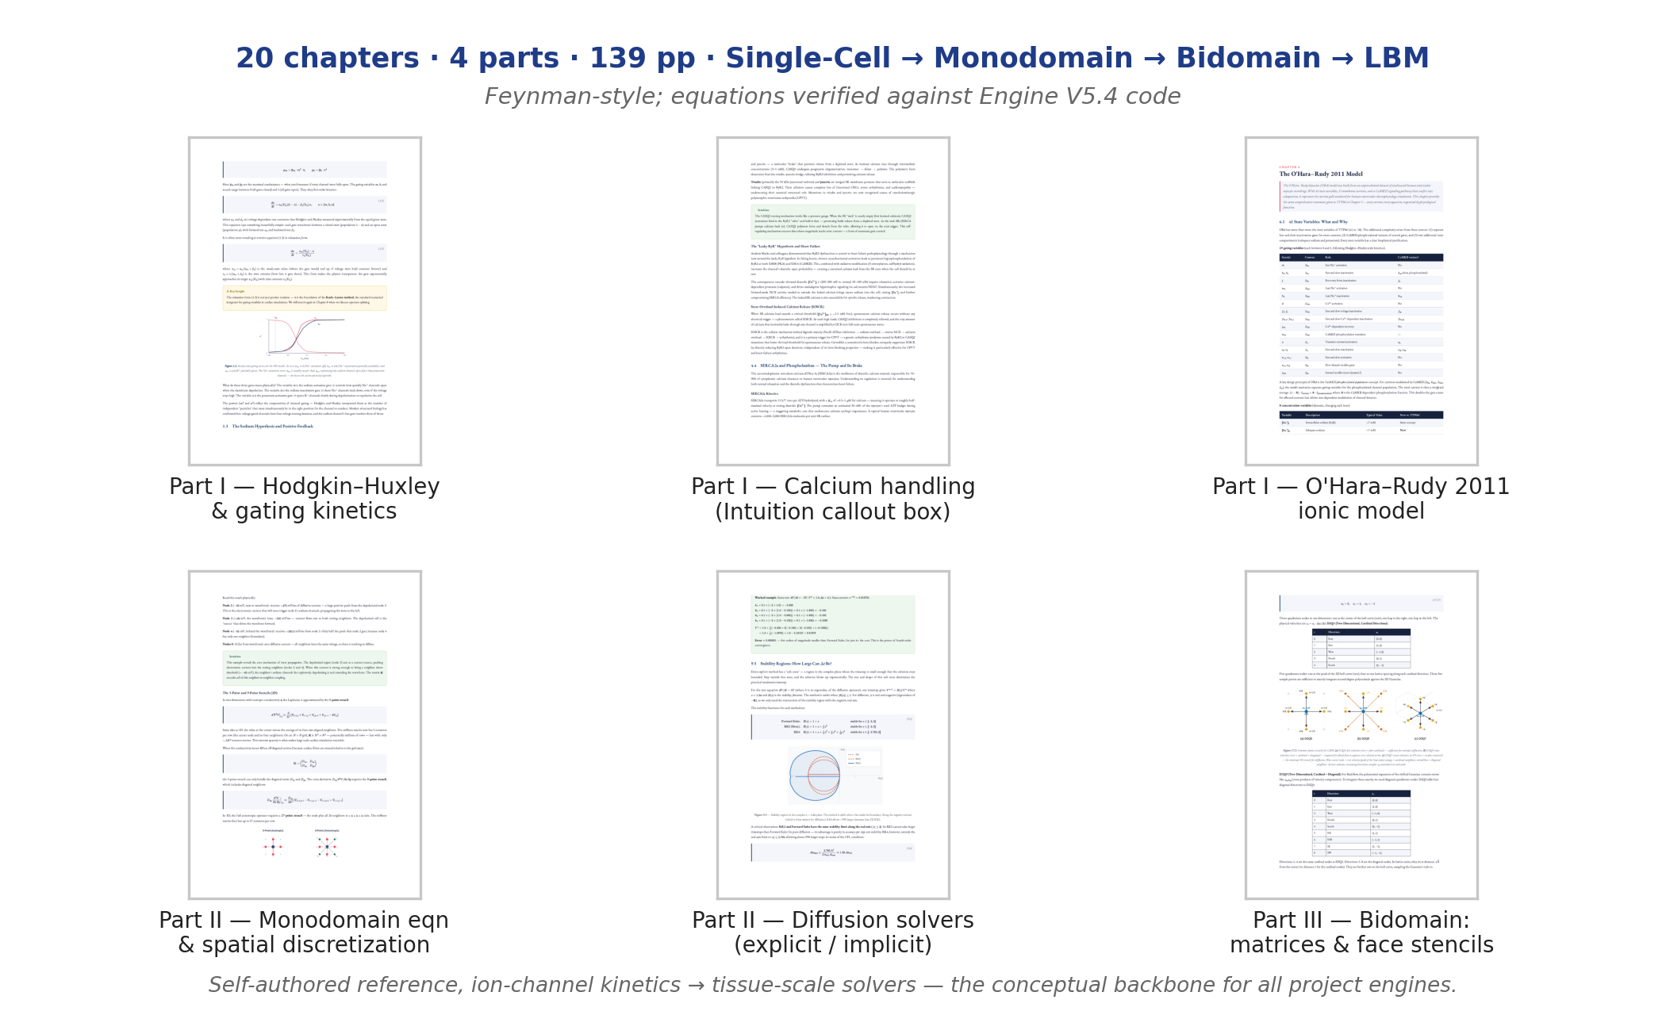
A Visual Cardiac-Modeling Textbook
Takeaway: a self-authored 139-page visual textbook (ion channels → bidomain solvers, equations verified against Engine V5.4) is the conceptual backbone behind the project's engines.

Slide 15
Future Goals
Fourier Fransform Encoding of Geometric Infarct Shapes
MLDO pipeline for worst geometry prediction
Completion of handoff materials
- Claude MCP for Monodomain, Bidomain, and LBM
- Computational Cardiac-electrophysiology Textbook

